Slide 1
Power BI Part - I
Visuals List

Slide 2
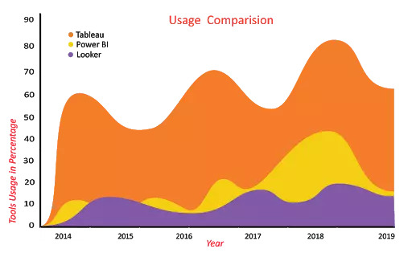
1 Area Charts
The area chart depends on line charts to display quantitative graphical data. The area between the axis and lines is commonly filled with colors, textures, and patterns. You can compare more than two quantities with area charts. It shows the trend changes over time and can be used to attract the attention of the users to know the total changes across the trends.
For Instance:
The below Area chart clearly shows you how the usage of Tableau, Power BI, and Looker varies over the past six years.

Slide 3
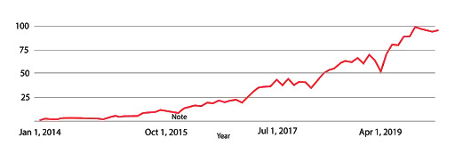
2. Line Charts
Line charts are mostly used charts to represent the data and are characterized by a series of data points connected by a straight line. Each point in the line corresponds to a data value in the given category. It shows the exact value of the plotted data. Line charts should only be used to measure the trends over a period of time, e.g. dates, months, and years
For Instance:
The below line chart shows the popularity of the Microsoft Power BI keyword in Google search across the world. It's clearly indicating that the popularity of Power BI has been increasing gradually since its inception.

Slide 4
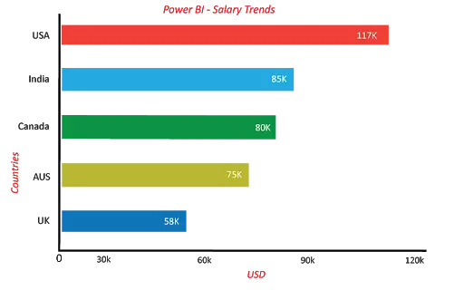
3. Bar Charts
In the list of Power BI visualization types, next, we are going to discuss bar charts.
Bar charts are mostly used graphs because they are simple to create and easy to understand. Bar charts are also called horizontal charts that represent the absolute data. They are useful to display the data that include negative values because it is possible to position the bars above and below the x-axis.
For Instance:
We have shown you the Power BI Developer Salary trends (Based on neuvvo.com) in different countries using the bar chart.
The above image shows the comparison of Power BI developer Salary trends in 5 different countries (UK, India, Canada, Australia, USA).

Slide 5
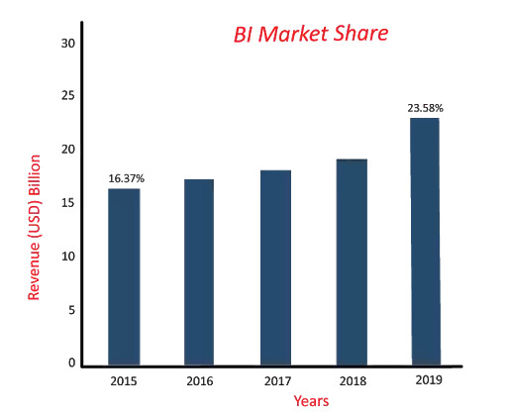
4. Column Charts
Column charts are similar to bar charts, and the only difference between these two is, column chart divides the same category data into the clusters and compares within the clusters. Also, it compares the data from other clusters.
For Instance:
Let us consider one example in which we compared the BI market share with the past years.
If you have observed the below column chart, it is clear that the BI market share has been increasing gradually.

Slide 6
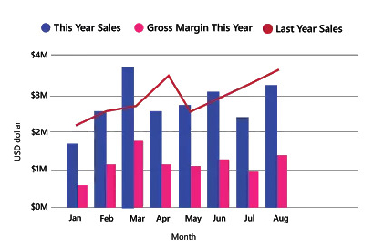
5. Combo Charts
A combo chart is a combination of both the column charts and line charts that help you to make a quicker comparison of the data. The combo chart shows the relationship between two measures in a single visualization. It also helps to compare multiple measures with different values.
For Instance:
In the above combo chart, you can see the comparison between last year's and current year's sales of a product and also the current year's gross margin. With the help of this combo chart, an organization can quickly analyze the data about the product to make business decisions quickly.

Slide 7
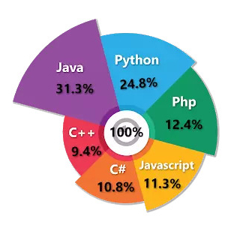
6. Pie Charts
A pie chart is a circular statistical chart, and it shows the whole data in parts. Each portion of a pie chart represents the percentages, and the sum of all parts should be equal to 100%. The whole data can be divided into slices to show the numerical propositions of each part of the data. Pie charts are mostly used to represent the same category of data. It helps users to understand the data quickly. They are widely used in education, the business world, and communication media.
For Instance:
In the below Pie chart, it is clear that which programming language is on the top list in 2019.

Slide 8
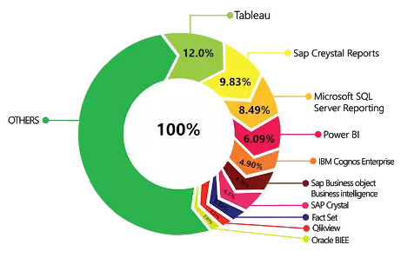
7. Doughnut Charts
Doughnuts are similar to pie charts, and it is named doughnut chart because it looks similar to a doughnut. You can easily understand the data because doughnut charts show the whole data into the proposition. It is the most useful chart when you need to display various propositions that make up the final value.
For Instance:
Let us consider an example, top BI tools market share across the globe.

Slide 9
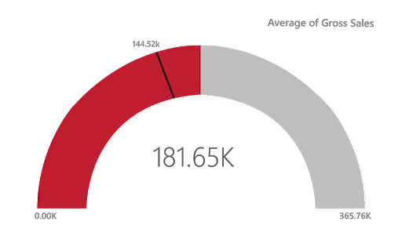
8. Gauge Charts
A gauge chart is also known as a speedometer or dial chart. It uses the needle to read the data, and it shows the information on a dial. The gauge chart, it represents the value of each needle as it reads the data according to the axis or colored data. These charts are useful to compare the values between the variables either by using multiple needles on the same gauge or different gauges.
For Instance:
The above gauge chart shows you the average gross sales of the company.

Slide 10
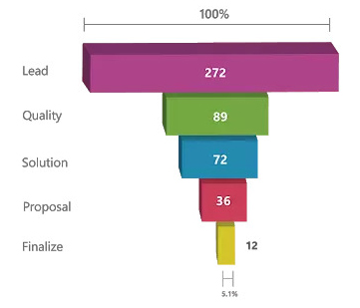
9. Funnel Charts
The funnel chart is a type of chart which is used to visualize the data that flows from one phase to another phase. In the funnel chart, the whole data is considered as 100%, and in each phase, it is represented as numerical propositions of the data.
For Instance:
The above Funnel charts show the flow of each phase. In the below image you can see the total leads per day is 272, the quality leads are 89, solution leads are 72, proposal leads are 36, and finalize leads are 12.

Slide 11
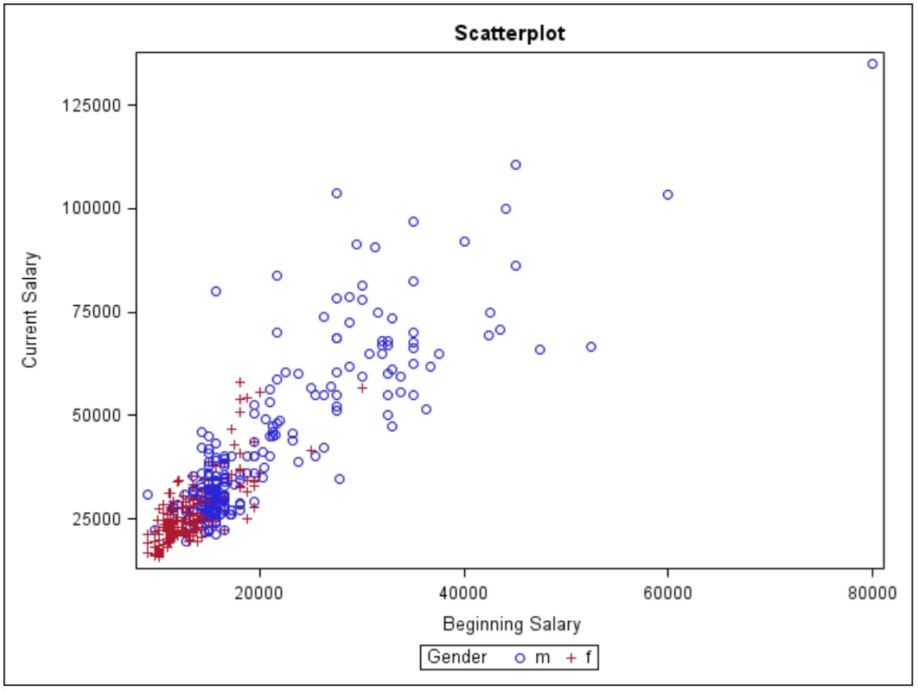
10. Scatter Charts
Scatter charts are used to visualize the data using the dots that represent the values obtained from two different variables, such as the x-axis and y-axis. These charts are used to show the relationship between two different variables. It is also called a correlation plot because it shows how two variables are correlated to each other.

Slide 12
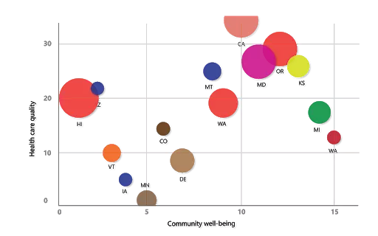
11. Bubble Charts
Bubble charts show the data in the form of a circle. The values of the variables are represented by the x-axis and y-axis. The size of the circle represents the measure of the variables.
For Instance:
In the below bubble chart, you can observe that on X-axis, the community is measured, and quality is measured on Y-axis. Each bubble represents the size of the community.

Slide 13
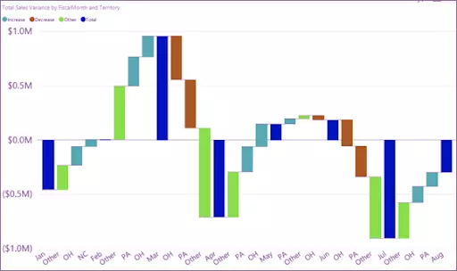
12. Waterfall Charts
A waterfall chart is used to show how initial values are increasing and decreasing gradually by a series of values to arrive at the final value.
For Instance:
Let us consider an example in which you can plot your company's annual profit in different countries, and you can add different sources of income and losses to know the net profit of your company.

Slide 14
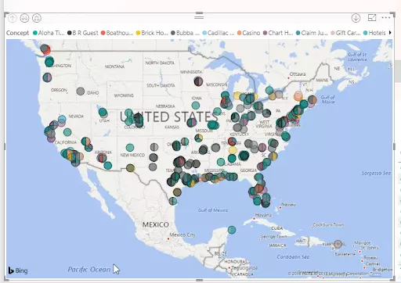
13. Maps
Maps are divided into three types, and they are listed below:
(A) Regional Maps (B) Point Maps (C) Flow Maps
A) Regional Maps:
Regional maps use different colors to represent the distribution of a specific range of values on the map.

Slide 15

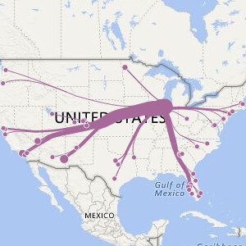
B) Point Maps
A point map is used to represent the geographical distribution of data by plotting the same size points on the geographical background. It helps the user to grasp the overall distribution of the data, but it is a tough task if you want to observe specific data.
Point Maps
C) Flow Maps
A flow map is a type of map that is particularly designed to show specific themes connected with a particular geographical area. It is used in cartography to show the movements of the objects between two or more areas
Flow Maps

Slide 16
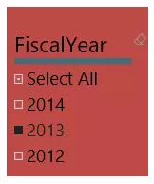
14. Slicers Charts
Slicers charts are visual filters. Using slicers, you can filter or sort your data by clicking on the type of data you want. In the below example, you can see all-region sales. In case if you want to see particular region sales, then click on that region, and it shows the specific region's sales.

Slide 17
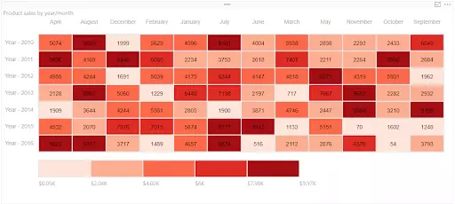
15. Tree Maps
Tree maps display hierarchical data set in a nested rectangle. At each level, hierarchy is represented by a color. The size of the space in the rectangle depends on the data values. The rectangular boxes are arranged in size from top left to bottom right.
For Instance:
For example, you are analyzing your sales, and you have top-level branches for clothes categories: Rural, Mix, Youth, and Urban. Power BI tree maps split your categories into rectangle boxes (leaves); these boxes would be shaped and sized based on the number of sold.

Slide 18
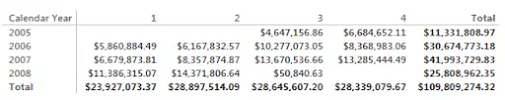
16. Matrix Chart
A Matrix chart shows the relation between two or more variables in a data set. It is mainly made up of columns and rows to represent the data in the grid format. At least two variables are required to create a matrix chart if there is any third or fourth variable, and color or other dimensions that can be added to the matrix to represent the data.
For Instance:
The below matrix chart represents the company’s revenue in different years with other factors.

Slide 19
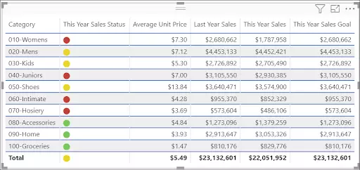
17. Tables
A table is a grid that contains the related data in a series of rows and columns. Tables are useful if you are comparing the same category for many values.
For Instance:
In the below example, you can see the same category having multiple measures to compare.

